Slide 1
Quantitative Portfolio Optimization
Team NAPPERS

Slide 2
Summary
Goal: Develop an end-to-end portfolio optimization pipeline that constructs monthly, long-only equity portfolios on an S&P 500–like universe and evaluates them against simple benchmarks using strictly out-of-sample performance.
Current Project Scope:
Focuses on monthly, long-only, fully-invested equity portfolios; excludes leverage, shorting, options, and intraday trading.
Restricts evaluation to historical backtests on the sp500_monthly sample
Includes infrastructure, testing, and documentation as primary goals so that future extensions (e.g. new signals, risk models, or universes) can plug into the same framework.

Slide 3
Objective
This objective balances four components:
Expected return: rewards allocations toward assets with higher estimated mean returns (estimated from rolling historical data).
Risk penalty​: penalizes portfolio variance, with γ\gammaγ controlling risk aversion.
Weight regularization​: discourages extreme or highly concentrated allocations by penalizing large absolute weights.
Turnover penalty​: penalizes deviations from last month’s portfolio, serving as a proxy for transaction costs and encouraging stability over time.

Slide 4
Data
Sourced from Wharton Research Data Services (WRDS)
S&P 500 daily data (2000 - present)
Useful fields include: date, ticker, price, return, shares outstanding, SIC codes
Pros:
Dataset is cleaned and reputable
Long historical coverage (25+ years of daily data, over 3,000,000 rows)
Breadth of data (returns are pre-calculated, outstanding shares and volume included)
Cons:
Limited in scope beyond straightforward applications of portfolio optimization
Huge dataset - computationally expensive, could lead to overfitting
Access limitation - potentially leads to complications with theoretical distribution/real-world implementation of model
Moving forward:
As project advances, we may need to acquire supplementary data - finer or coarser grain date-wise depending on eta
In order to differentiate from previous project, may need to search for more niche dataset to narrow our application (ESG, alternate optimization strategy such as a two layer model or higher moments)
If pivoting to prediction markets, data reputability and cleanliness decreases, risks accuracy or hallucination since sourced from GAI

Slide 5
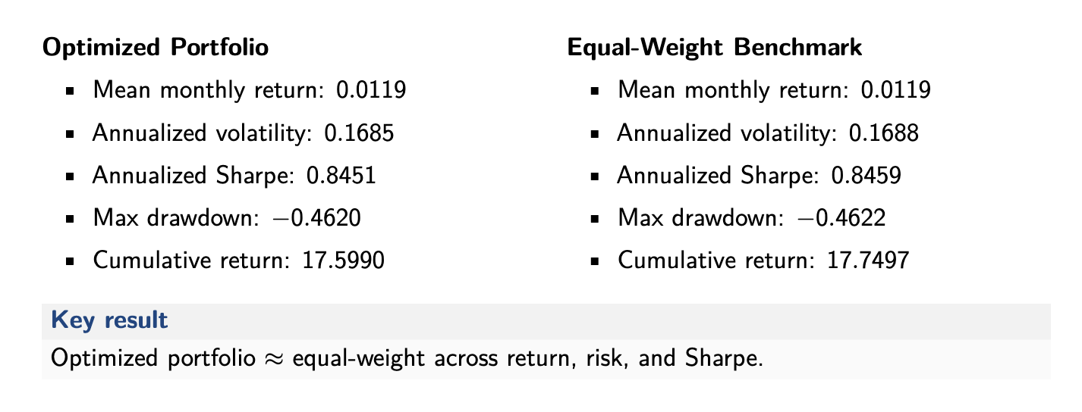
Preliminary Results

Slide 6
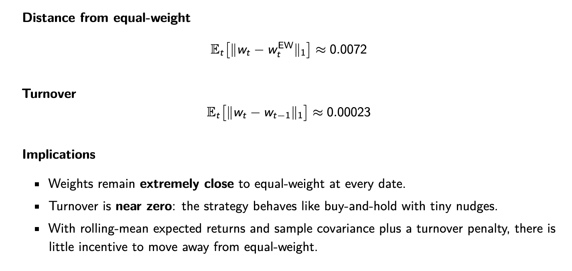
Preliminary Results

Slide 7
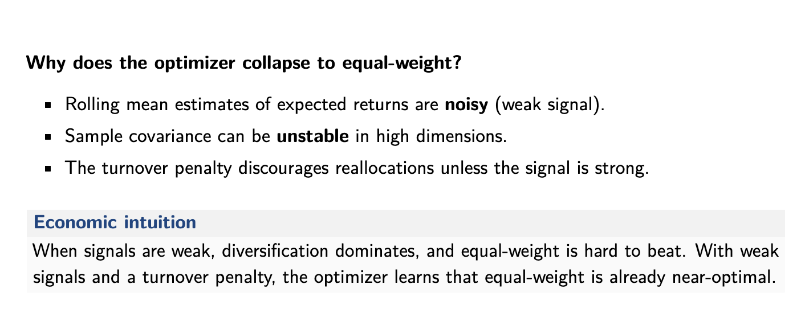
Preliminary Results
Notes:
Ensure that the code is correct. And ensure that the turnover parameter is small enough.

Slide 8
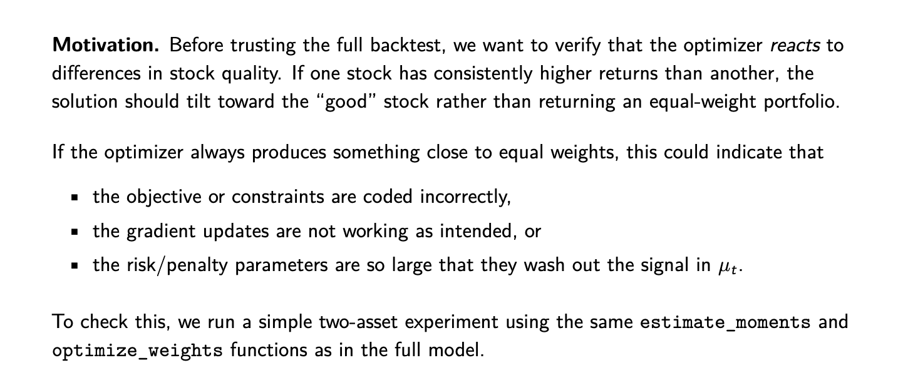
Verifying the Optimizer
Notes:
Ensure that the code is correct. And ensure that the turnover parameter is small enough.

Slide 9
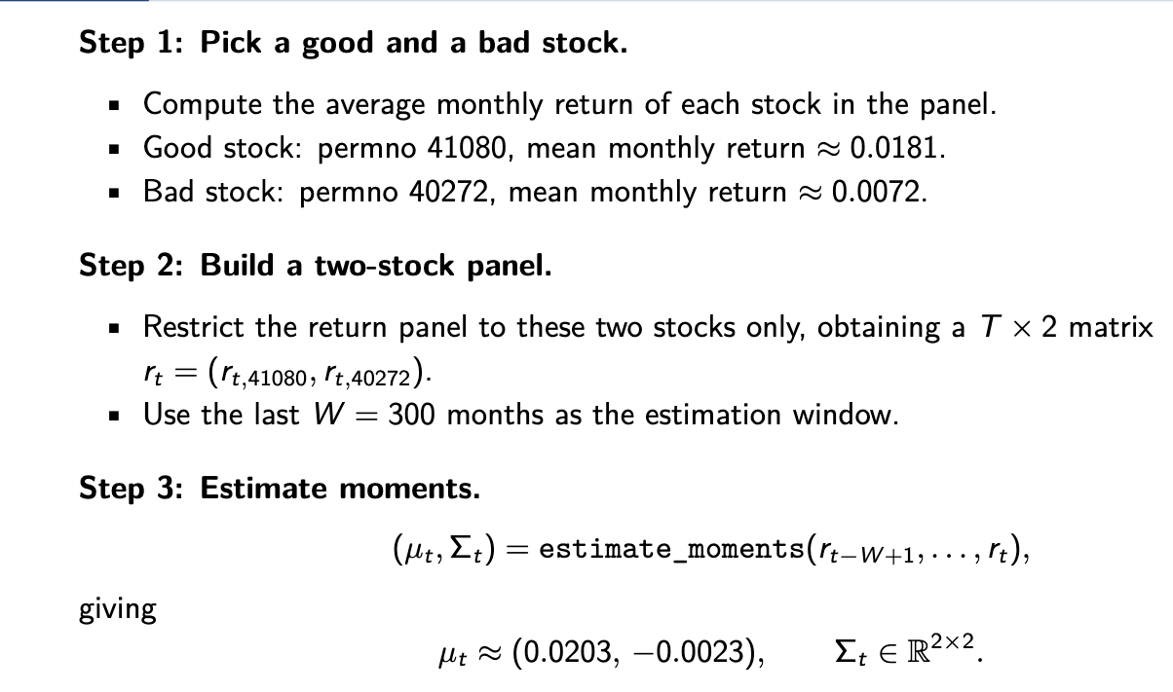
Verifying the Optimizer
Notes:
Ensure that the code is correct. And ensure that the turnover parameter is small enough.

Slide 10
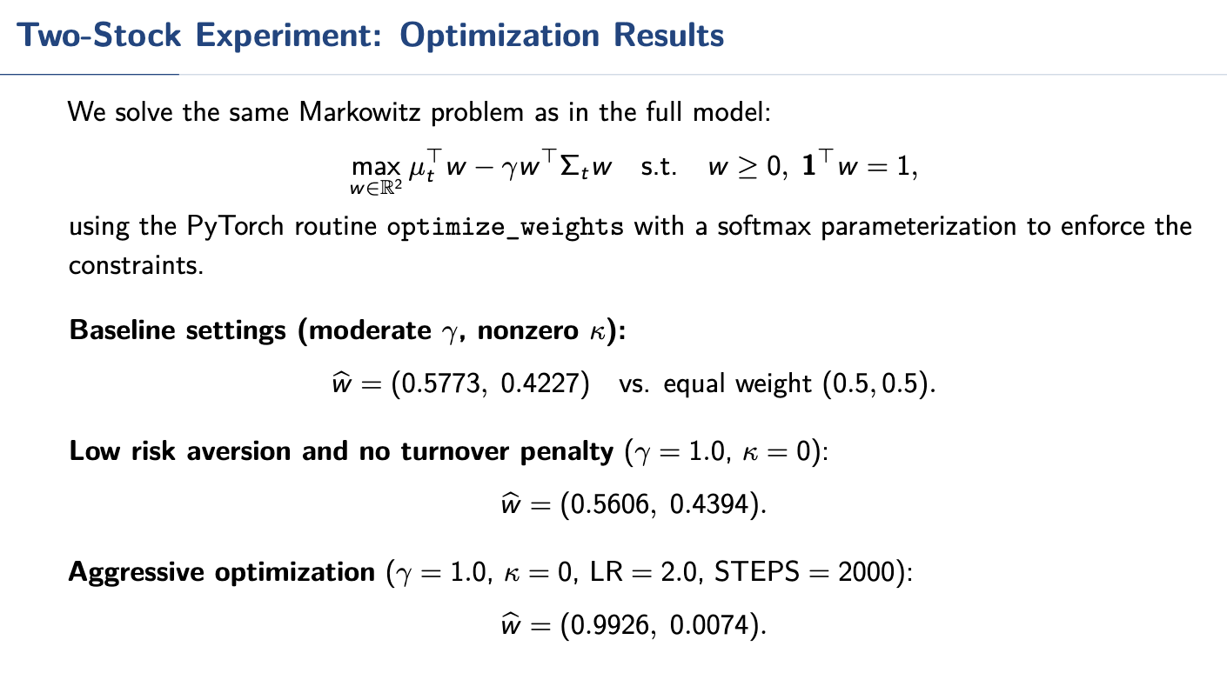
Verifying the Optimizer
Notes:
Ensure that the code is correct. And ensure that the turnover parameter is small enough.

Slide 11
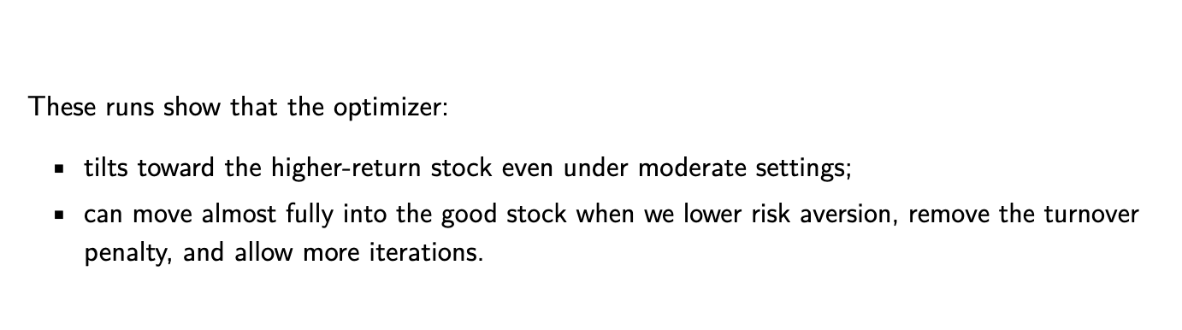
Verifying the Optimizer
Notes:
Ensure that the code is correct. And ensure that the turnover parameter is small enough.

Slide 12
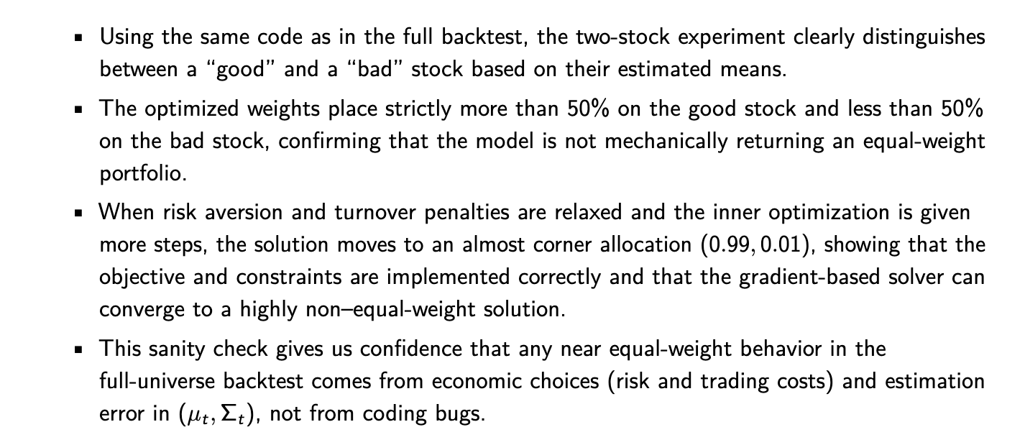
Preliminary Results
Notes:
Ensure that the code is correct. And ensure that the turnover parameter is small enough.

Slide 13
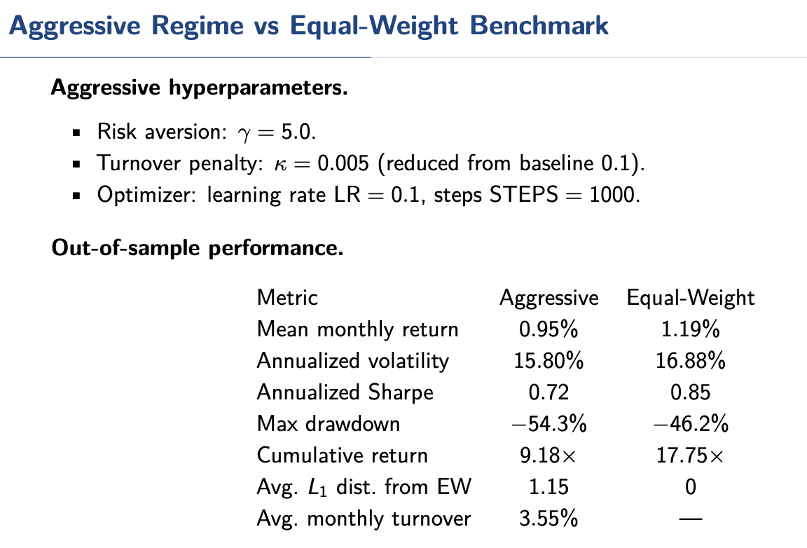
Aggressive Regime
Notes:
Ensure that the code is correct. And ensure that the turnover parameter is small enough.

Slide 14
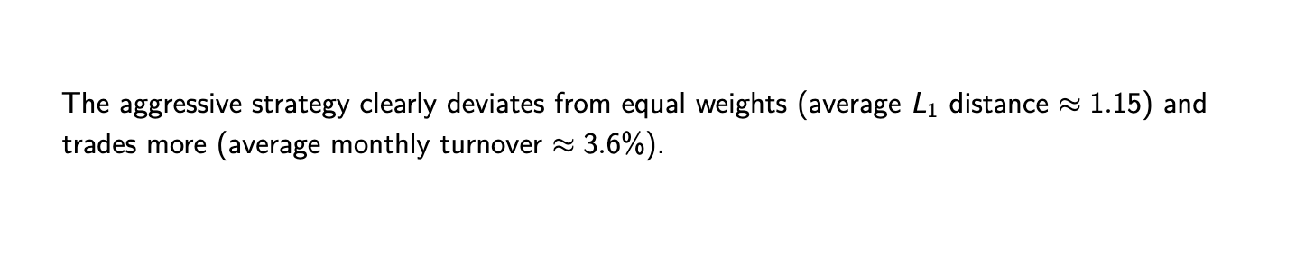
Aggressive Regime
Notes:
Ensure that the code is correct. And ensure that the turnover parameter is small enough.

Slide 15
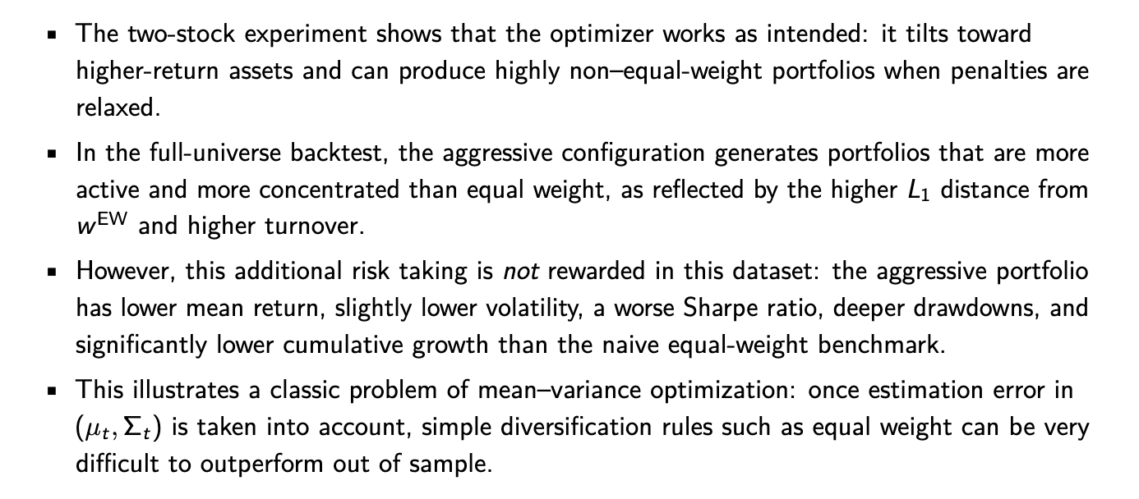
Aggressive Regime
Notes:
Ensure that the code is correct. And ensure that the turnover parameter is small enough.

Slide 16
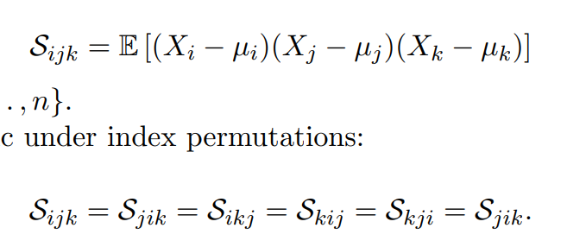
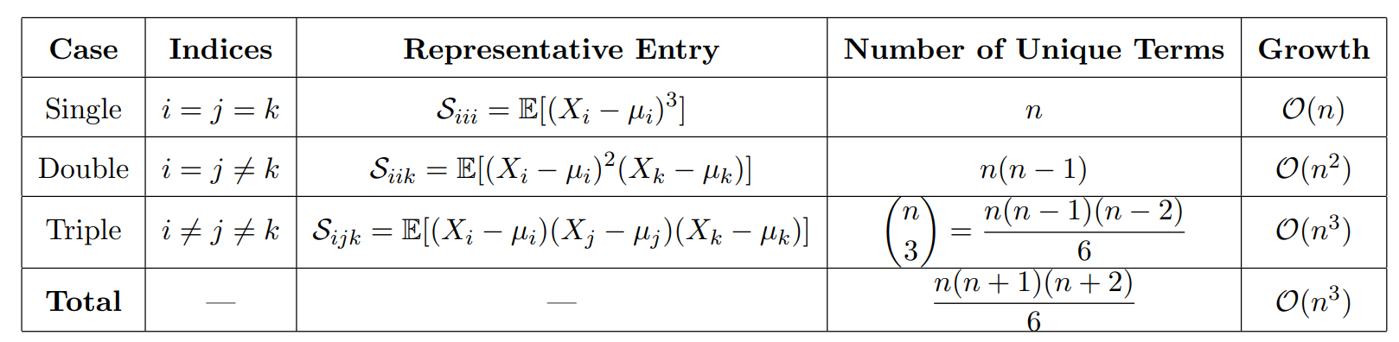
Exploration: Skew Tensor

Slide 17
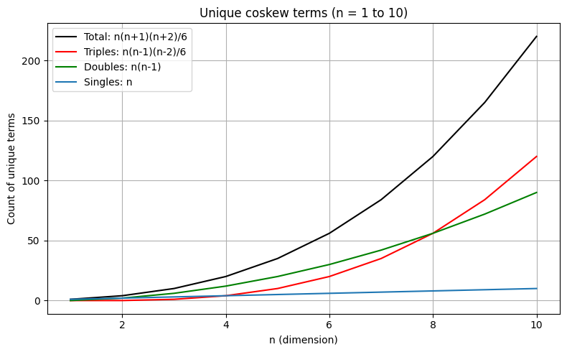
Exploration: Skew Tensor 2
As dimensionality increases, the structure of coskewness becomes overwhelmingly dominated by
triple-variable interactions.
This has implications for:
• Storage complexity,
• Estimation stability,
• Regularization needs,
• Dimensionality reduction strategies.

Slide 18
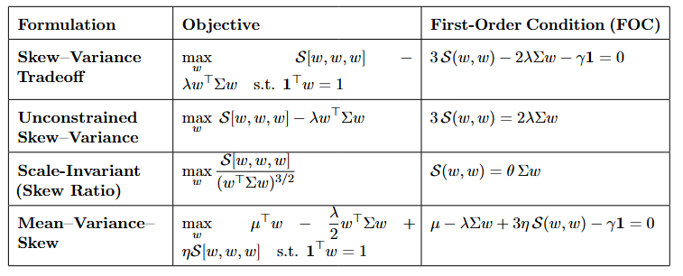
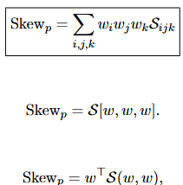
Exploration: Skew Tensor 3
For portfolio optimization we want to maximize the portfolio skew at the cost of portfolio variance, where portfolio skew is defined by the contraction of the tensor over the weight indices.

Slide 19
Ideas for GPU Usage
GPU-based hyperparameter sweeps
Run large-scale parameter sweeps (risk aversion, constraints, signal weights)
Compare multiple portfolio construction strategies in parallel
Leverage GPU to speed up model training and evaluation loops
Identify robust configurations across market scenarios
RAPIDS library cuDF/cuML for large panel data
Accelerate large panel data operations (joins, groupbys) on GPU
Handle firm × time datasets more efficiently than traditional pandas
Reduce preprocessing bottlenecks in feature engineering pipeline
Most impactful for high-frequency or very large datasets
Monte Carlo Simulation for optimization
Simulate thousands of return scenarios in parallel using GPU tensor operations
Replace slow loops with vectorized PyTorch computations (CUDA-enabled)
Enable more robust portfolio optimization under uncertainty (scenario-based)
Improve runtime → allows deeper sensitivity analysis and parameter sweeps
Resampling the efficient frontier by averaging optimal portfolio weights across simulations
Used to explore a single more specialized arm of exploration
Convert text data (news, filings, ESG reports) into embeddings using transformer models
Generate forward-looking risk signals (e.g., controversy, climate exposure)
Use GPU to scale inference across large text corpora efficiently
Integrate signals directly into expected return or risk models

Slide 20
Prediction Markets Exploration
Exploring prediction markets as a possible pivot for project direction
Prediction markets = a marketplace where people trade contracts whose payoff depends on a future event
Price of a contract reflects market’s belief about the probability of that event occurring.
Prices resolve to $0 (impossible event) or $1 (certain event)
Interesting marketplace that aggregates distributed information among participants
Previously relatively unexplored optimization framework (at least in the context of this class)
High fraud risk due to insider trading resulting from lack of regulation in participation
Arbitrage between prediction market hosts

